Slide 1

Educational platform enhanced by interactive historical AI models
Done by: Al Haj Ahmed
Carp Dan Octavian
Group: FAF211

Slide 2

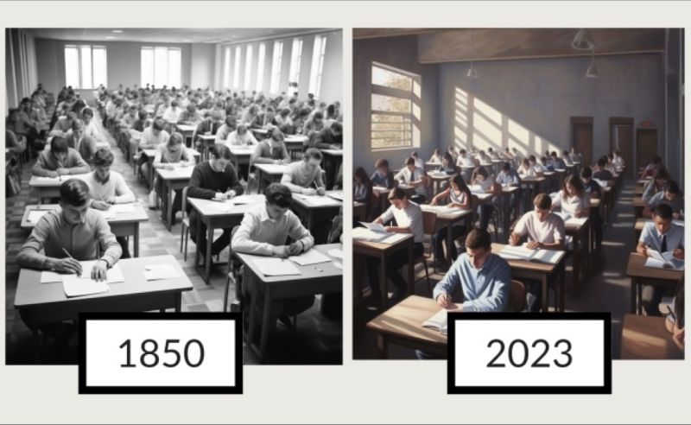
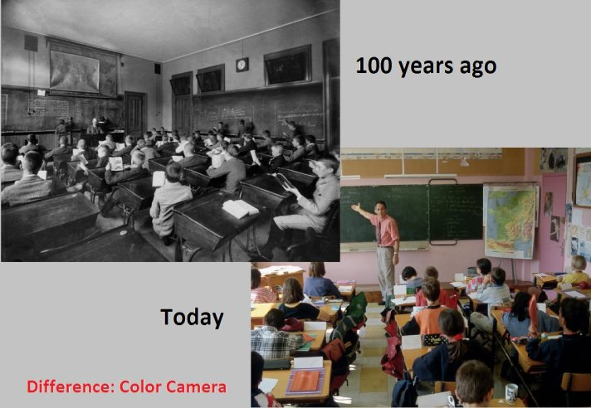
The Problem
The Challenge with Traditional Education
Students often feel disconnected or bored
One-size-fits-all teaching isn't effective
Limited engagement with historical subjects
Lack of personalized support
Notes:
"Let’s face it — textbooks and lectures can only go so far. Many students struggle to connect with history, and the current education system lacks personalization and interactivity."

Slide 3
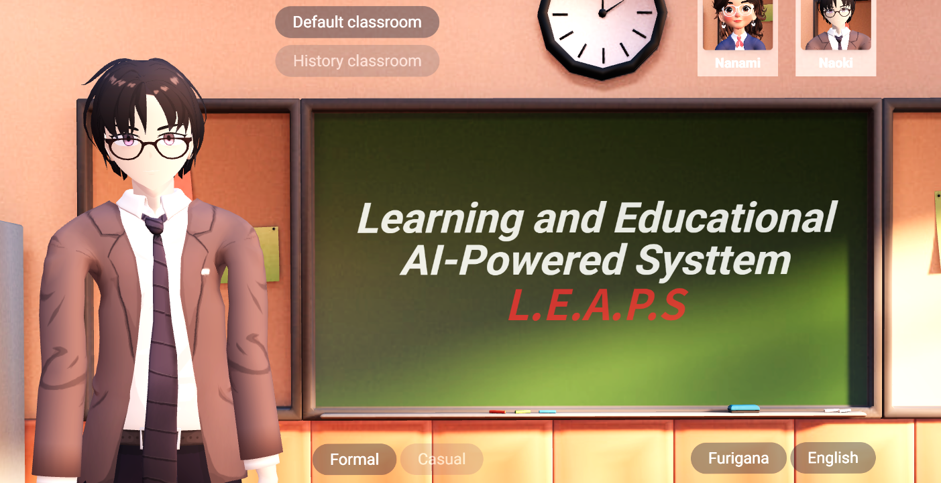
Our Solution
Meet LEApS – Learning with AI-Powered Personas
AI recreations of historical figures like Einstein & Tesla
Real-time conversations, quizzes, and explanations
Personalized, fun, and immersive classrooms
Voice, text, and 3D interaction support
Notes:
"What if students could talk to Einstein? Or get writing advice from Shakespeare? With LEApS, they can — using AI to simulate personalities and knowledge of iconic figures."

Slide 4
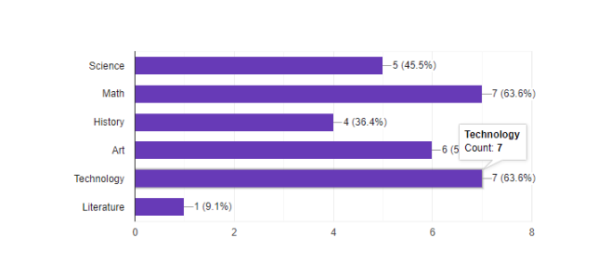
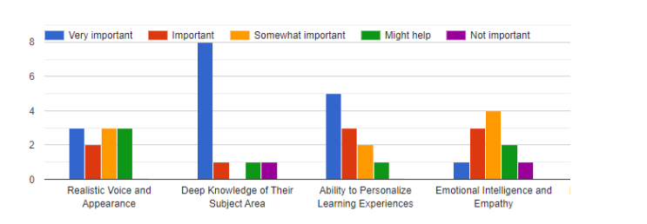
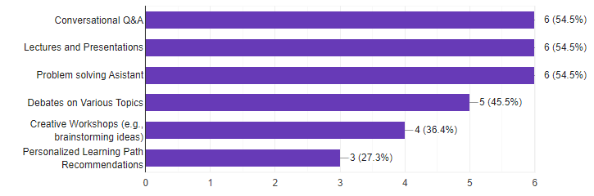
Validation & Research
Do Students Want This?
Surveyed 50+ students
80% prefer personalized AI tutors
Most requested: Scientists (Einstein, Tesla)
Realism is less important than knowledge & interaction
Notes:
"Before building, we asked real students what they needed. The response was clear — people want knowledgeable, interactive, and flexible learning tools."

Slide 5
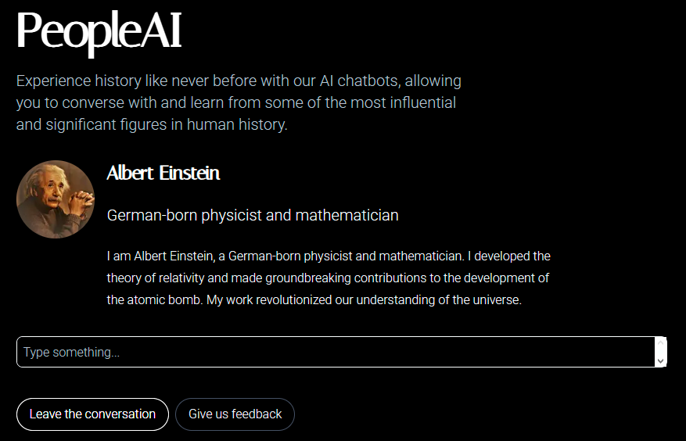
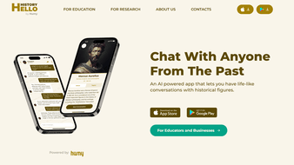
Similar Solutions
People AI
Hello History
Notes:
"What if students could talk to Einstein? Or get writing advice from Shakespeare? With LEApS, they can — using AI to simulate personalities and knowledge of iconic figures."

Slide 6
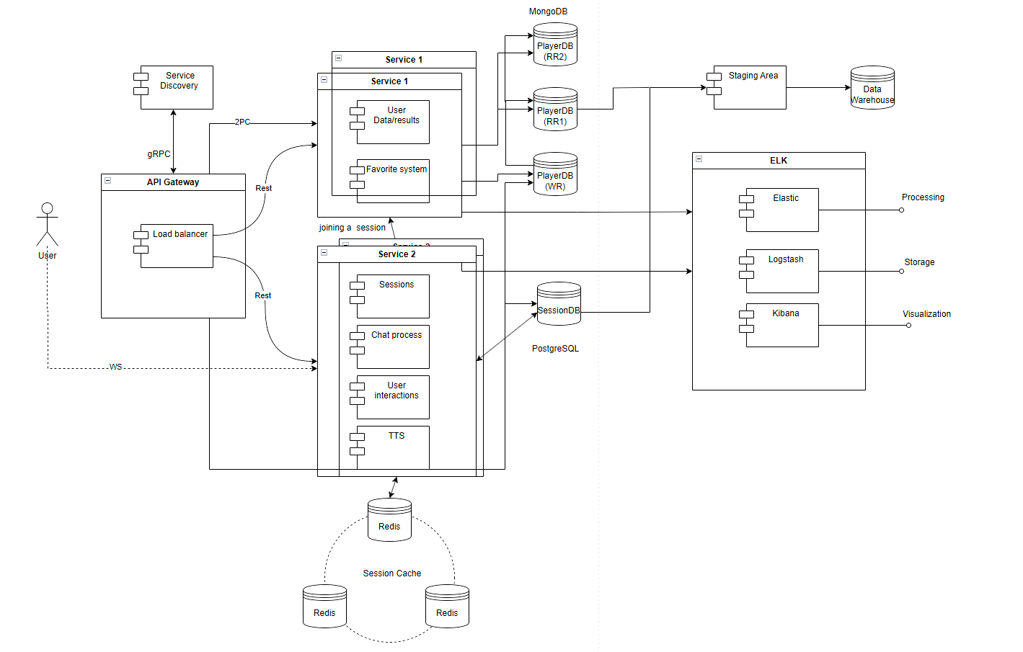
Static Architecture
Notes:
"What if students could talk to Einstein? Or get writing advice from Shakespeare? With LEApS, they can — using AI to simulate personalities and knowledge of iconic figures."

Slide 7
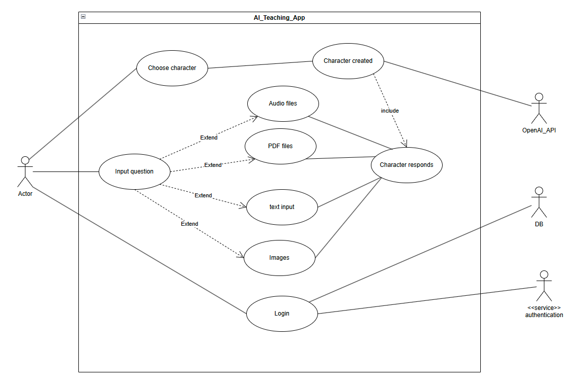
Use Cases
Notes:
"What if students could talk to Einstein? Or get writing advice from Shakespeare? With LEApS, they can — using AI to simulate personalities and knowledge of iconic figures."

Slide 8
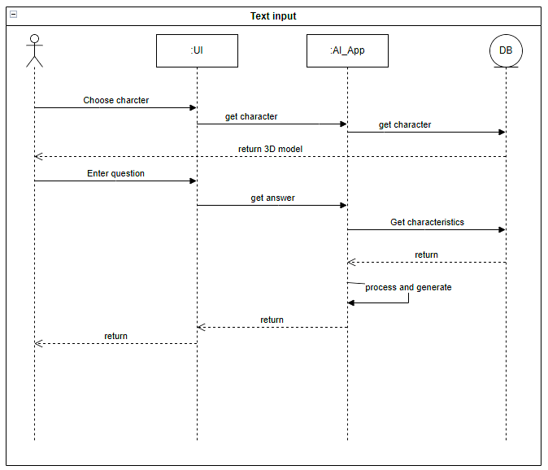
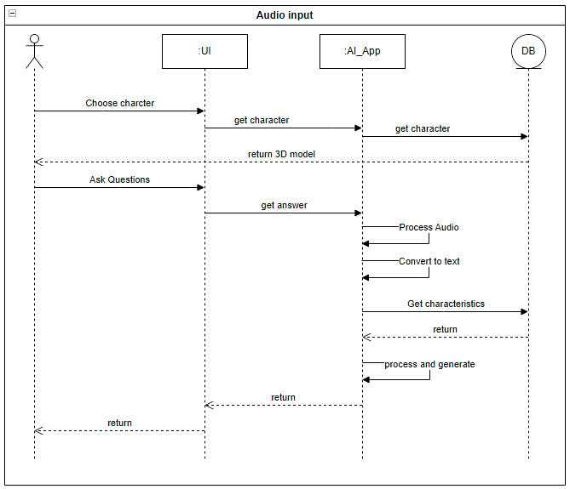
Sequence diagrams
Notes:
"What if students could talk to Einstein? Or get writing advice from Shakespeare? With LEApS, they can — using AI to simulate personalities and knowledge of iconic figures."

Slide 9




Tech Stack breakdown
Behind the Scenes: The Tech Stack
Frontend: 3D classrooms built with JavaScript/HTML
AI Engine: Ollama (LLM), ChromaDB for knowledge recall
Voice Interaction: Text-to-Speech (Azure), Lip-sync
Backend: nodejs
Notes:
"We use modern tools like Ollama, Azure TTS, and ChromaDB to deliver fast, intelligent, and emotionally engaging interactions — all within a web platform."

Slide 10
Personalized Learning Experience
What Makes It Special?
Adaptive to student’s pace & style
Roleplay-like interaction with AI figures
Supports multiple subjects (History, Art, Language)
Real-time feedback, and coaching
Notes:
"It’s more than a chatbot. LEApS adjusts to how students learn, speaks their language, and makes every session feel personal and meaningful."

Slide 11
Cost & Feasibility
Scalable and Cost-Efficient
MVP built using free/open-source tools
Hosted locally or via cloud for flexibility
Modular microservice architecture
Future-ready: add more characters, subjects, languages
Notes:
"This isn’t just a prototype — it’s scalable. We used open-source tools to keep it affordable and made sure it can grow with time and need."

Slide 12
What’s Next?
Integrate with school systems or as a stand-alone app
Expand character library (philosophers, artists, leaders)
Bring personalized learning to rural & remote areas
Potential for monetization as an ed-tech solution
Notes:
"LEApS can be used in schools, museums, or at home. It’s a tool for democratizing education and making history feel alive — for everyone."

Slide 13
Why This Matters
Education is not the learning of facts,
but the training of the mind to think." — Einstein
Combines education, technology, and imagination
Re-engages students with historical learning
Paves the way for smarter, AI-powered education
Notes:
"This project is about giving students more than facts — it’s about bringing back curiosity and making learning something to look forward to."

Slide 14


Slide 15

Denumirea subcapitolului PT Sans Bold 30 pt
PT Sans Regular 20 pt

Slide 16

Plasați textul

Slide 17
Plasați textul
Bullet text
Bullet text subnivel (accesați TAB)
Shift și Tab trece textul inserat la un nivel mai înalt
Bulleturile apar, când accesați butonul următor:

Slide 18
Denumirea subcapitolului
“
Aici se plasează un citat.
Nume funcție

Slide 19

“
Aici se plasează un citat.
Nume Funcție

Slide 21



Slide 22
